Slide 1
WORLD OF DRONE
Drone Application: Agriculture

Slide 2
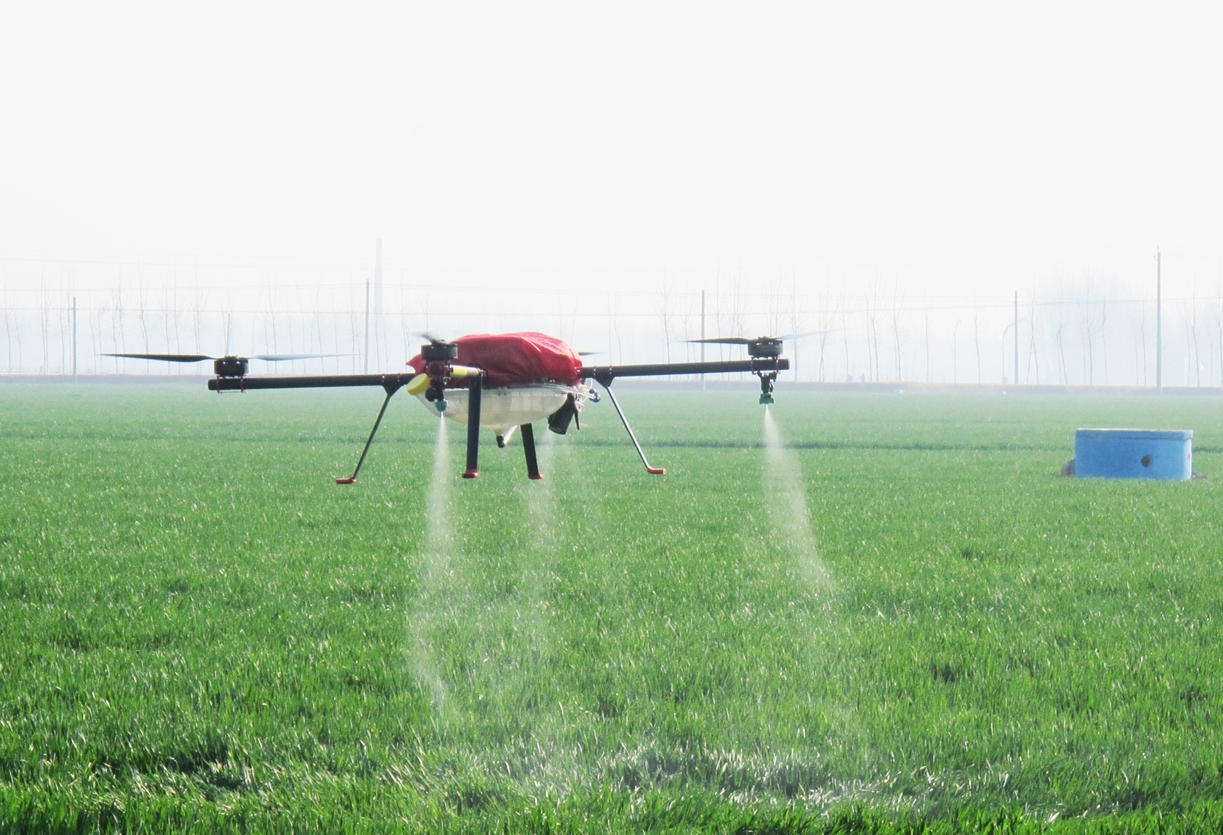
Drone Application: Agriculture
Japanese farmers have been using Yamaha's R-50 and RMAX unmanned helicopters to dust their crops since 1987.

Slide 3
?
Drone Application: Agriculture
Some farming initiatives in the U.S. use UAVs for crop spraying, as they are often cheaper than a full-sized helicopter.

Slide 4
?
Drone Application: Agriculture
UAV are also now becoming an invaluable tool by farmers in other aspect of farming, such as monitoring livestock, crops and water levels.

Slide 5
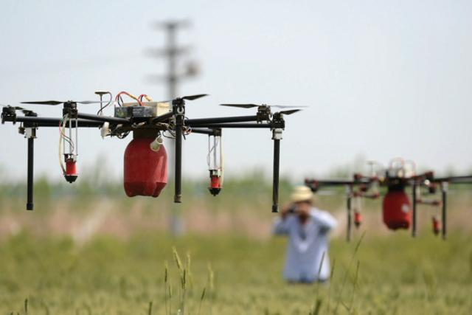
?
Drone Application: Agriculture
The core applications in agriculture are: identify pests and harmful natural factors that occur each year and affect the yield.

Slide 6
?
Drone Application: Agriculture
Sophisticated UAV have also been used to create 3D images of the landscape to plan for future expansions and upgrading.

Slide 7
?
Products for Treating Pests/Diseases in Drones
Cabbage Culture
Pest Removal: bite cabbage (DELIA BRASSICAE)
Treatment: IMIDAN 50 WP - 0,1 % - spray solution.

Slide 8
?
Products for Treating Pests/Diseases in Drones
Peaches and Apricots Orchards
Pest Removal: striped moth
Treatment: Mixture based on CYPERGUARD, DITHANE, EFORIA and ROVRAL 500.

Slide 9
?
Products for Treating Pests/Diseases in Drones
Vine
Disease Control: blight, powdery mildew and gray mold of grapes.
Treatment: Mixture based on CURZATE MANOX, TOPSIN and APOLLO.

Slide 10
?
Products for Treating Pests/Diseases in Drones
Apple Orchard
Pest Removal: apple worm
Treatment: Mixture using insecticid Decis Mega 50 EW

Slide 11
?
Products for Treating Pests/Diseases in Drones
Mulberry Orchard
Pest Removal: Hyphantria cunea
Treatment: Spray of Insecticide CALYPSO

Slide 12
?
Drone Application: Agriculture
In addition, drone in agriculture can be used for identifying: moisture deficit area, deforestation and land reclamation.

